Slide 1
Meditation for critical thinking, focus, creativity, and stress management
Sharon Doetsch-Kidder, PhD

Slide 2
What questions do you have about mindfulness?
Notes:
How many people have meditated before?
Take notes on questions

Slide 3
Benefits of Mindfulness Practice for Learning
Develops capacity for focus/attention
Reduces stress and anxiety
Strengthens metacognition
Relaxes judgmental thoughts
Improves resilience
Increases confidence, persistence, and empathy for self and others
Encourages thoughtful exploration
Supports intellectual, creative, and personal development
Notes:
Some of this comes from scientific studies, some is philosophy
Reactivity is the problem
Over 700 studies in NIMH database

Slide 4
What is meditation? Calm abiding Being present Mindfulness-awareness
“how to work openheartedly with life just as it is”
–Pema Chodron, Start Where You Are
Holistic Life Foundation, Baltimore, Maryland
Notes:
Meditation is a practice that develops mindfulness, the ability to focus on the present moment. It usually involves assuming an upright posture, and focusing attention on an object, such as a sound or the breath. It includes practicing letting go of thoughts that arise and bringing attention back to the object as many times as necessary, without judgment.

Slide 5
What do we mean by Mindfulness-Awareness?
Mindfulness: Consciously and purposefully directing your attention
Awareness: Being open to and aware of the environment within and around you
Nonjudgmental
Balance between gentle and precise: Not too tight, not too loose

Slide 6
What is mindfulness meditation?
3 main elements:
In the present moment (anchor in TIME)
Aware (anchor in PLACE)
Non-judgmental (anchor in PSYCHOLOGICAL STATE)
Notes:
Giving your naturally busy mind an intentional object to come back to again and again – every time you recognize your mind is wandering and come back to the present, it strengthens your brain and changes your habit
Recognize the difference between being caught up in your thoughts and coming back to where you are – flying a kite: get carried away watching kite flying around and forget that we’re the ones holding the string – we always had the control; we’re not doing anything artificial

Slide 7
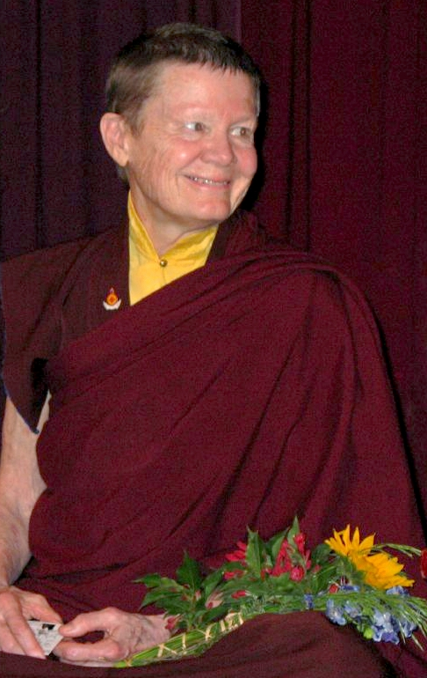
Seeing ourselves honestly
“We are not trying to get rid of our thoughts. Rather, we are clearly seeing our defense mechanisms, our negative beliefs about ourselves, our desires and expectations. We also see our kindness, our bravery, our wisdom.”
–Pema Chodron, The Places That Scare You
Notes:
Chodron, Pema (2001). The Places That Scare You: A Guide to Fearlessness in Difficult Times. Boston: Shambhala: p. 27-8.

Slide 8
Why meditate?
Meditation allows us to TAME and TRAIN our mind so that we can…
know our own present state of mind
be available to others
attune to the environment around us
choose how to act rather than simply reacting based on habitual or emotional patterns

Slide 9
Acceptance – Appreciation – Empowerment
“You, just as you are, and your life here, right now, are all there is and all you need to know. You don’t have to do anything special. Mostly, you have to be open to meeting face to face, and even dancing with, the truth that pertains to your life right now. You have to find a way to collect your fractured pieces, examine them, and then accept them as part of who you are. Spiritual practice is about transformation, but it’s also, and more importantly, about working with what is.”
--Rev. Angel Kyodo Williams

Slide 10
“We already have everything we need. There is no need for self-improvement.” –Pema Chodron, Start Where You Are

Slide 11
Mindfulness practices for the classroom
Meditation
Moment of silence
Stretching
Pausing
Listening exercises
Combine with writing
Notes:
Whatever you practice at home
Turn and talk about what you might do
OR practice giving instruction
Would people like to practice giving instruction and receive feedback? -> could form a group

Slide 12
For more information
Mason’s Center for the Advancement of Well-being: https://wellbeing.gmu.edu/
Various centers in the region to learn more
See me if you want more information (sdoetsch@gmu.edu)

Slide 13
A few references
Goleman, Daniel, & Davidson, Richard (2017). Altered Traits: Science reveals how meditation changes your mind, brain, and body. New York: Avery.
Ricard, Matthieu, Lutz, Antoine, & Davidson, Richard J. (2014). Mind of the meditator. Scientific American 311:5, Nov. 2014, p. 38-45.
Shapiro, Shauna L., Brown, Kirk Warren, & Astin, John (2011). Toward the integration of meditation into higher education: A review of research evidence. Teachers College Record 113: 3, March 2011, p. 493–528.
Ramsburg, Jared T., & Youmans, Robert J. (2014). Meditation in the Higher-Education Classroom: Meditation Training Improves Student Knowledge Retention during Lectures. Mindfulness 5, p. 431–441.
Waters, Lea, Barsky, Adam, Ridd, Amanda, & Allen, Kelly. (2015). Contemplative Education: A systematic, evidence-based review of the effect of meditation interventions in schools. Educational Psychology Review 27, p. 103-134.
Sarath, Ed. (2006). Meditation, creativity, and consciousness: charting future terrain within higher education. Teachers College Record 108:9, Sept. 2006, p. 1816-1841.

Slide 14
Meditation Practice
BODY:
Feet flat on floor
Spine straight
Chin slightly tucked
Hands relaxed on thighs
Gaze 6-8 feet in front and down
MIND:
Attention on breath
Feel your body breathing
Notice when thoughts arise
Bring your attention back to your breath
Notes:
Being present
Acceptance (thinking), appreciation (of human body and mind), empowerment (posture)

Slide 15
Training your brain
Being present with difficult emotions
Pema Chodron: What are you adding to the world?
Repetition
Dan Siegel’s Hand model of the brain: Name it to tame it

Slide 16
Daily Practice
Find/create a special place where you live
Start by sitting 5 minutes/day, gradually increase if you want
Connect with others: teacher, books/videos, other practitioners
Create daily rituals: mindful breathing at beginning and end of day and other times when you remember

