Slide 1



Affecting Social Change Through Research for Multi-disciplinary International Students
Deborah M. Sanchez, Ed.D
Aimee Weinstein, D.A.
September 21-25th, 2020

Slide 2
An Introduction: English for Academic Purposes 507/508
INTO Mason - International graduate students from various disciplines
Co-taught by a composition specialist and a language specialist
A team of INTO and English department faculty regularly co-teach the course
Final deliverables: Literature Review and Poster Presentation
The Mission of George Mason University
“...we are an innovative and inclusive academic community committed to creating a more just, free, and prosperous world.” https://www2.gmu.edu/about-mason

Slide 3
Impetus for Project change
Our team noticed that many projects focused on “how to make money” for businesses; market-oriented research projects
We had a desire to encourage research projects which align more with the mission of GMU
Many students come from parts of the world where the climate crisis is negatively affecting their communities

Slide 4
Team Conversations
Can we mandate a social exigence for the students?
If we do have a program-wide focus for all of the students, can all disciplines connect with the social problem we choose?
We are trying to teach three types of rhetorical exigencies:
  Personal - why do I want to do this project?
  Social - what is the problem in the world that I can address with this project?
  Research - what gap in “the literature” can I address with this project?
All disciplines can connect to the challenge of climate change

Slide 5
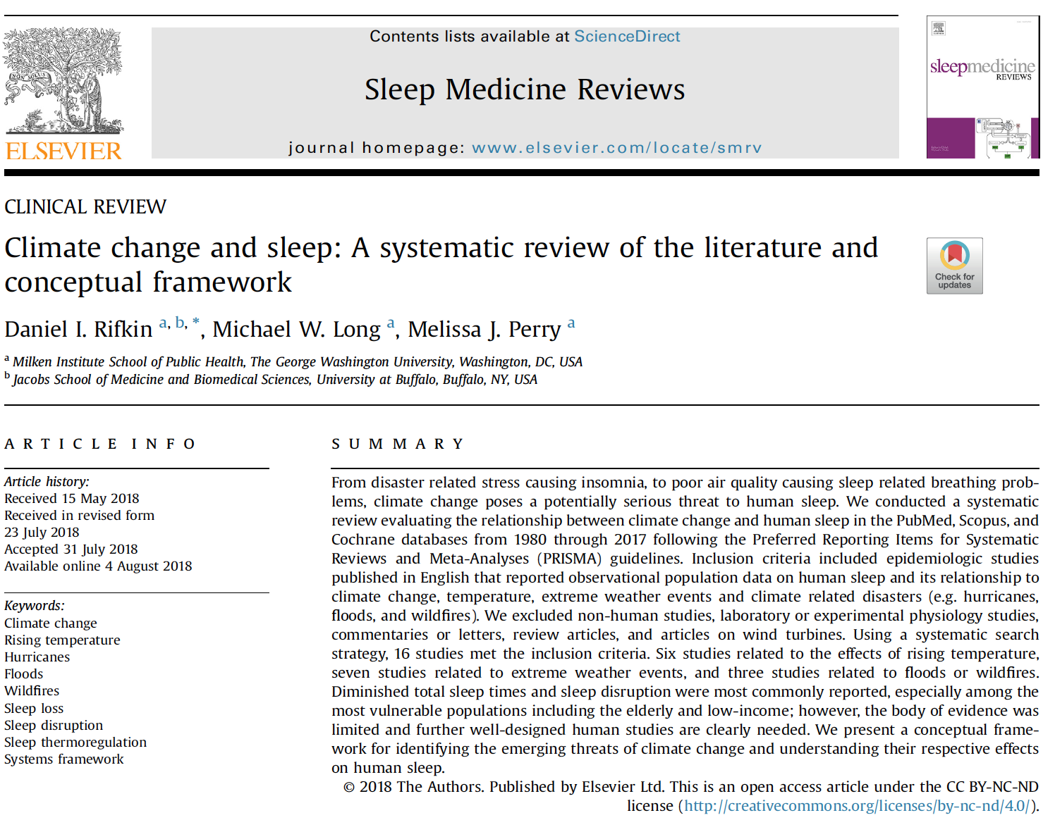
Begin with a Model Literature Review
Students’ final project is a literature review
They start by reading a lit review which models how any discipline can connect to the global climate crisis.

Slide 6
Activities which helped students make the connection
Curiosity journal
  a brainstorming exercise to help decide on a semester long project
  Sample questions: How is climate change affecting communities in your native country? In the world?
Why are these issues important to you?
What are some topics in your discipline which might relate to the negative outcomes listed above (disease, displacement and death of people and animals) or others not mentioned?
Conversations with group members
Academic writing and research is a “conversation” among scholars

Slide 7
Project examples
Using R and GIS to visualize the correlation between rainfall and malaria prevalence due to global warming (Data Analytics/GIS)
Addressing challenges and opportunities of genetic modification technologies related to agricultural production with climate change (Bioinformatics/Health Informatics)
The impact of climate change on classroom environment and student motivation (Educational Psychology)
Age differences in the effect of using social media to the recovery of social networks for climate migrants (Industrial and Organizational Psych/Cognitive Psychology)

Slide 8
Next Steps
Normally we do a multidisciplinary colloquium but we could not in Spring 2020
We did not mandate a social exigence for Fall 2020
We hope to go back to the experiment next term - and have a colloquium to present projects all based on the same social exigence

Slide 9
Questions?
Aimee Weinstein, D.A. aweinste@gmu.edu
Deborah M. Sanchez, Ed.D. dsanch12@gmu.edu

