Slide 1


Incorporating Action Research for Big Social, Ecological and Learning Impacts
Drs. Susan Allen, Meagan Call-Cummings, Elizabeth DeMulder,
Dann Sklarew, Jessica Srikantia and Jenice L. View present:
D

Slide 2
Overview
What is Action Research?
Who are we?
How do we each use Action Research in our teaching?
Multidisciplinary Action Research Course for CEHD, EVPP, S-CAR, SCHAR
What opportunities do you see to strengthen Action Research at Mason?
(Join us! Contact jview@gmu.edu)
S
Notes:
- 5 mins -- Overview of agenda — we will ask them to engage at the end, please note your questions and be ready to engage at the end
— ask them to join us in exploring the opportunities to strengthen action research at Mason— will be explored in last 15 minutes
— what Action Research is (Susan and Jenice-by phone/internet), note working on problems or opportunities

Slide 3
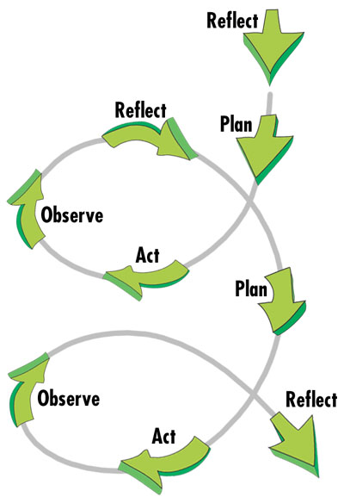
What is Action Research?
Democratic and participative knowledge creation to address issues of concern.
Co-creation of knowing with people, not on or about people.
Sources: http://cadres.pepperdine.edu/ccar/images/action%20research.jpg ; http://en.wikipedia.org/wiki/File:Systems_Model_of_Action-Research_Process.jpg ; http://celt.ust.hk/files/public/arcycle.jpg ; http://www.whataboutus.org.uk/make_a_difference/action_research_cycle/Action_research_cycle.jpg ; http://www.enquirylearning.net/ELU/Issues/Research/Res1Ch4A.GIF

Slide 4
How to use AR in classes?
Impacts? Lessons?
Jenice L. View (Graduate School of Education)
Jessica Srikantia (Schar School of Policy & Gov.)
Betsy DeMulder (GSE)
Meagan Call-Cummings (GSE)
Susan Allen (S-CAR)
Dann Sklarew (Environmental Science & Policy)
Notes:
- 18 mins— How we each use Action Research in different domains and classes (3 mins per person) noting working on problems or opportunities
— Jenice- by phone/internet, Jenice’s individual action research
— Jessica (scaffolding students through action research process, being ok with open endedness of action research)
— Betsy (transformative teaching)
— Meagan (CEHD doctoral program)
— Susan (conflict resolution action research)
— Dann (developing sustainably thru AR tumbles and pivots)

Slide 5
4th Grade Students
Classroom teacher
NPS Interpreters
PD researchers
Jenice View:

Slide 6

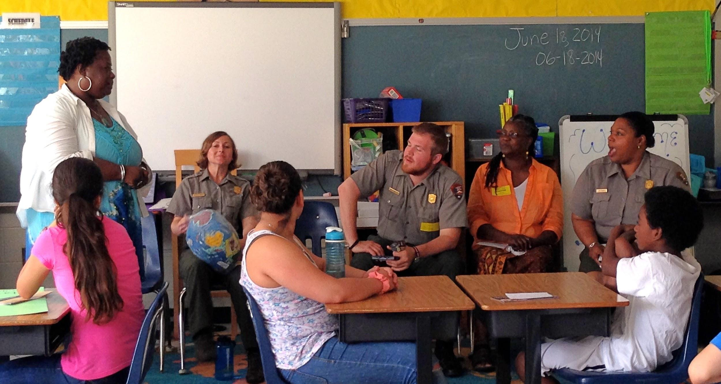
Learning Historic Places with Diverse Populations
Jenice View:

Slide 7
Teaching PAR building blocks
Jessica Srikantia:
Inner shifts
  Relinquishing control
  Comfort with ambiguity
  Significance of 2nd order meanings/realities vs just content-level
  Appreciating process vs only outcomes
Outer challenges
  institutional structures (e.g., dissertation requirements, deadlines for deliverables)
  Social, cultural and institutional rewards for ownership/control

Slide 8
Lessons and Challenges
Jessica Srikantia:
Shifts in mindset happen with scaffolding
Ongoing mindfulness required to achieve AR at process level of practice
AR invites learning new ways to relate in groups
Outer pressures can create tendencies to default to outcome orientation, content over process, etc.

Slide 9
Teacher Action Research:
Improving Teaching & Learning
Betsy DeMulder:
Process Starts with Intentional Questions:
A problem from your classroom
A puzzle or dilemma about the learning of a particular student or group of students
A question you have about your teaching
A situation that has arisen in your classroom
How to develop and support particular learning qualities
(e.g., motivation, engagement, etc.)

Slide 10
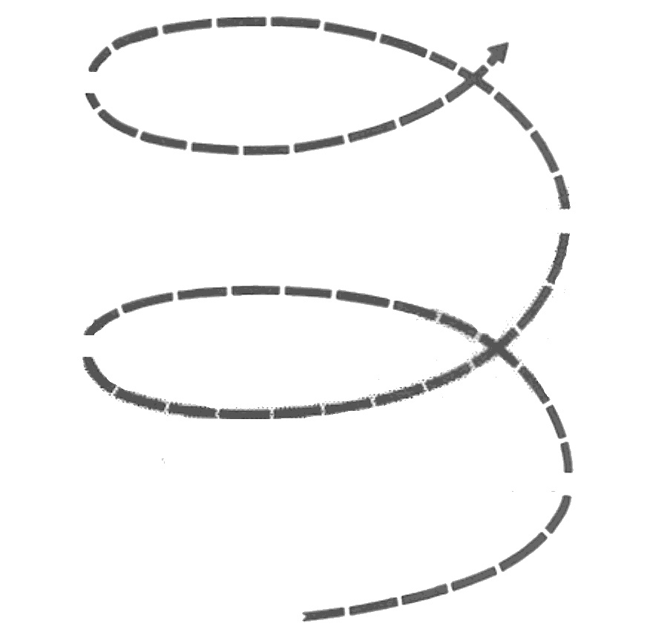
Betsy DeMulder:
ASSESS
need for a change or action
(Data Collection & Analysis)
IMPLEMENT
the change or action
(Try out new strategies)
S
R
A
STUDY
the results
(Data Collection & Analysis)
I
S
R
A
RETHINK
the need, the change, and the results
(Reflection & Dialogue)
I
A
CONTINUOUS IMPROVEMENT THROUGH
TEACHER ACTION RESEARCH

Slide 11
“Teaching” PAR at CEHD
Meagan Call-Cummings:
Voices/experiences/expertise of historically marginalized should be meaningfully included at every step
Each class section is different, depending on “community’s” (students’) interests
Last year: “True Stories of Mason PhD Students”
Goal: create more “empowering” PhD programs at Mason

Slide 12
Local High School Community Action Group (CAG)
Meagan Call-Cummings:
Invited by principal to “build community”
Working with teachers and students
Data collection and analysis 2017-2018
Finding: Ask the “hard” questions
Action: Create space and time for courageous dialogue with people we don’t know, don’t understand, don’t agree with
Continue to collect data, iterative process
PAR in schools is hard

Slide 13
AR in Conflict Resolution
Susan Allen:
Graduate Courses
  Applied Practice and Theory Courses
  Engaging Current Conflicts
Doing conflict resolution practice with teams from across the conflict divides
Recent Action Research Dissertations
  Phil Gamaghelyan
  Rochelle Arms
Notes:
Susan single slide

Slide 14
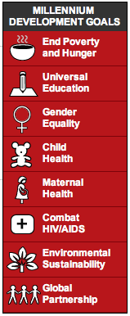

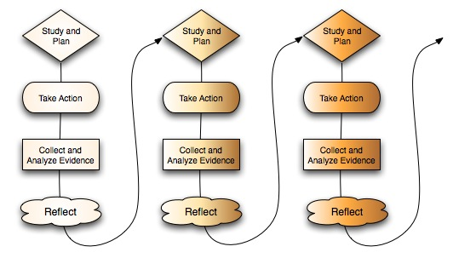
Think Global, Act Local Scale AR
Dann Sklarew:
2000-2015 2015-2030
Notes:
Dann Slide 1

Slide 15
Think Global, Act Local Scale AR
Dann Sklarew:
AR Impacts
AR LESSONS LEARNED
New recycling programs at Dick’s, Red Bull, Starbucks, skate park and 4 mosques
Students develop AR and project mgmt. skills
Building subject matter experience/expertise
Problem/opportunity statement frames options
Conceive of a “novum,” test “Theory of Change”
Fumbles and pivots normal
Some projects realized across series of cohorts
Notes:
Dann Slide 2

Slide 16
Graduate AR Courses + Certificate
AR for Social Change and/or Environmental Sustainability
Fall Course: AR Theory and Practice
Spring Course: Practicum
Certificate planned to include the fall and spring course, plus three from home units.
Notes:
- 2 mins- Our courses and our certificate program- pitch — Susan and Jessica

Slide 17
Opportunities to strengthen AR @ Mason?
What do you suggest?
What opportunities do you see?
Notes:
- last 15 mins— Questions and discussion — how can we explore opportunities for strengthening action research at Mason? — Jessica and Dann
If you want to join our community, contact Jenice View jview@gmu.edu.

Slide 18
Want more Action Research?
To join our community,
please contact
Dr. Jenice L. View
jview@gmu.edu

