Slide 1
Enhancing teamwork in group projects by applying principles from Project Management
Jim Talman, Ph.D.
Adjunct Professor
George Mason University
Electronics Engineer
U. S. Naval Research Laboratory
Notes:
Introduction – who I am, where I work, etc.
I’m going to be talking about applying some basic principles from the field of Project Management to group projects in the classroom. The field of Project Management was pioneered by NASA in the 60’s for managing the space program. Now it is a well established discipline with certifications available.
I hope you find it interesting and helpful.

Slide 2
Outline
My class
Basic principles from Project Management (PM)
Applying basic principles from PM to group projects
Conclusions

Slide 3
My class
Introduction to Engineering
100 students, mostly first year
Major semester-long group project stressing teamwork – ABET requirement
25 groups of 4 students
All team members get the same grade
Notes:
The group project accounts for 30% of the final grade. The group project fulfills a requirement of ABET (Accreditation Board of Engineering and Technology) for all university-level engineering programs in the country.

Slide 4
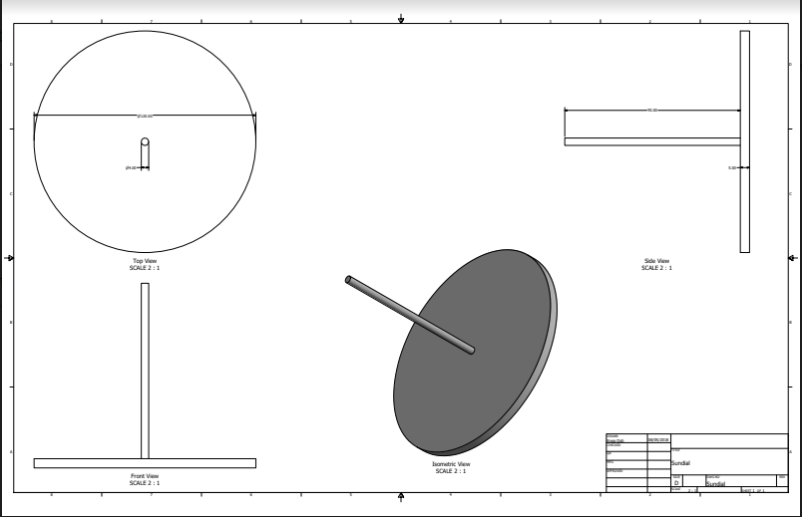
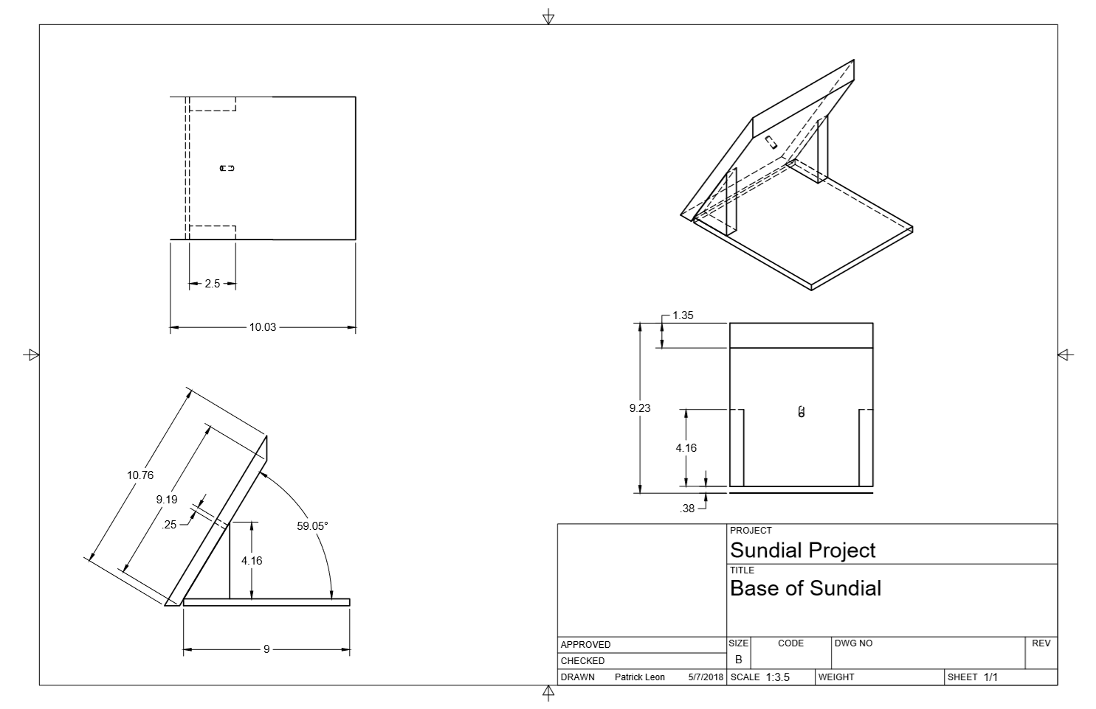
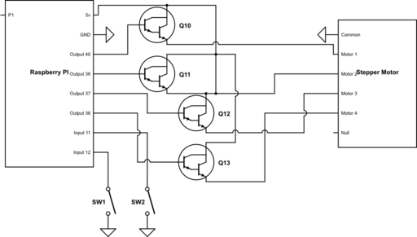
Example Group Project: Programmable Sundial
Notes:
Groups are expected to design and build their projects on a modest budget of $50 or so.
Groups are given several suggested topics to give them an idea of what is expected. Past examples have included a USB-powered refrigerator and an air-powered car. However, groups are encouraged to choose their own topic.
The group decided to make a programmable sundial. They built a mechanical sundial and programmed a Raspberry Pi device to drive a stepper motor to position the disk of the sundial correctly.
Key point: This team came up with their own topic. The best projects are always done this way.

Slide 5
Example project schedule (Gantt chart)
GROUP PROJECT | WEEK 1 |  |  |  |  |  |  | WEEK 2 |  |  |  |  |  |  | WEEK 3 |  |  |  |  |  |  | WEEK 4 |  |  |  |  |  |  | WEEK 5 |  |  |  |  |  |  | WEEK 6 |  |  |  |  |  |  | WEEK 7 |  |  |  |  |  |  | WEEK 8
Initiation Phase
Brainstorm
Conceptual design
Get parts
Build prototype
Test
Background report
Planning Phase
Agree on concept
Create WBS
Create schedule
Assign roles
Interim report
Execution Phase
Get parts
Assemble part
CAD drawings
Documentation control
Interim report
Closing Phase
Presentation
Final Report
Discuss with class
Notes:
8 week project. List tasks and completion dates, taking into account dependencies.

Slide 6
Basic principles from Project Management

Slide 7
Basic framework for Project Management (PM)
Sponsor
Upper management
Program manager
Project manager
Project manager
Specialists
Specialists
Team 1
Team N
Notes:
I’ve drawn the various players in a top-down logical fashion for clarity, but in reality the structure can be more complex. For example, the sponsor could be a member of upper management.
Key point: one team for each project and one project manager for each team.

Slide 8
Key principles
The team is the fundamental unit.
The team consists of a project manager and specialists.
One of the specialists could be the project leader, especially on big projects.
Each member of the team has at least one primary role (probably secondary role too).
Team members must all agree to take on a particular project.
Notes:
In industry, if someone is not interested they could be replaced. Obviously, this is not possible In the classroom. So, it is important to find a way to motivate the group.
Key point: Although I suggest possible project topics, I find the best way to have motivated students is to allow the teams significant freedom to select their own project topic. If team members all agree to take on a project from the outset, they are more likely to maintain interest and follow through.

Slide 9
What a project manager is NOT!
The boss
The owner
The project leader
Notes:
The project manager acts as more of a manager of the project than as a leader of the project. However, the role of project manager is still considered a leadership role.
It is an axiom of Project Management that on small projects “everyone does everything.” In this case it is possible for the project manager to end up working on the project as well as managing it.
Key point: So, that is the theory. What about the practice?
Story: How many of you have children that are part of a band or a sports team (show of hands) ? Have you noticed how the ones with a team mom are much more predictable and easier to handle? The coach runs the team, but the team mom keeps things running smoothly. The team mom is a project manager!

Slide 10
Applying basic principles from Project Management
to group projects

Slide 11
What can go wrong with group projects
The team is disorganized
A team member doesn’t contribute
One person does all the work
The team can’t finish on time
Notes:
The easiest way to handle groups is to randomly assign them in Blackboard. This certainly “works”, but it is risky. Many things can go wrong, resulting in every team member getting a bad grade.
Key point: most of the group meetings and work occur outside of the classroom (at least for my class). It is hard for the instructor to assess progress.

Slide 12
Application of PM to group projects
Sponsor = Parents
Upper management = University
Program manager = Professor
Project manager = Student
Specialists = Students
Team 1
Team N
Notes:
It is a simple matter to apply the Project Management framework from a few slides ago to group projects in the classroom.
Key point: Treat the groups as teams in need of a project manager. It is the job of the project managers to organize and schedule the project for their team.

Slide 13
Roles of group members in my class
Role | Responsibilities
Project manager | Managing, Planning, Presenting Leadership role, but not the only leader Interfaces with instructor
CAD leader | Leader of computer-aided design (CAD) drawing
Project engineer | Leader of design and assembly. On big projects, would be project leader.
Documentation leader | Leader of reporting interim and final results
Notes:
In my class, I assign projects that require multiple roles to be filled. Describe roles.
Key point: There is a key role for the project manager to play. It is important for the student who will fill this role to understand it thoroughly and to accept the responsibility willingly.

Slide 14
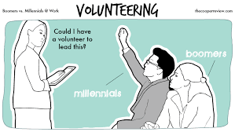
Project managers have got to want it!
Notes:
This slide tickled me because I’m a boomer. I distinctly remember a friend on my first job out of college, who happened to be former military, solemnly telling me to never volunteer for anything!
Fortunately, millennials and Generation Z’ers are more cooperative.
I ask first for volunteers for project manager and then for the other roles.
Key point: If the students volunteer in public they are more likely to take their role seriously. They are also more likely to be accepted by their fellow students.

Slide 15
How the project manager helps
Makes project schedule
Makes sure resources are available
Coordinates group meetings
Compares progress with schedule
Keeps instructor informed
Notes:
Most important thing for project manager is to make schedule. Budget not so important for such small projects.
If a team member is not contributing, the project manager can raise the issue with the Instructor. Fortunately, this has only been necessary a few times in my experience with 50 projects or so.
Key point: I attribute this to having all team members agree to the project in advance, assigning roles to each team member, and having volunteer project managers.

Slide 16
How to apply it to other fields
Choose projects with clear-cut roles.
Allow for team creativity in choosing the project topic.
Explain the roles and responsibilities clearly, especially those of the project manager.
Get volunteers for project managers, in public.
Notes:
The basic principles can be applied to any group project.
The project manager is responsible for the final presentation.

Slide 17
Example: English/History
Describe a key influence of one author on one aspect of society in a given time period.
Possible topics chosen by teams:
Team 1: Jane Austen, courting customs, Victorian England
Team 2: Augustine, church government, Medieval Europe
Roles
One student for each sub-topic. Must consider status quo before, during, and after.
Project manager coordinates timing and combines into final presentation.

Slide 18
Conclusions
Group work can benefit by applying some basic principles from the field of Project Management
Groups are teams in need of a project manager.
Empower the project manager by explaining the role clearly and asking for volunteers in public.
All team members must agree from the outset on the project topic and on their respective roles.

